Slide 1

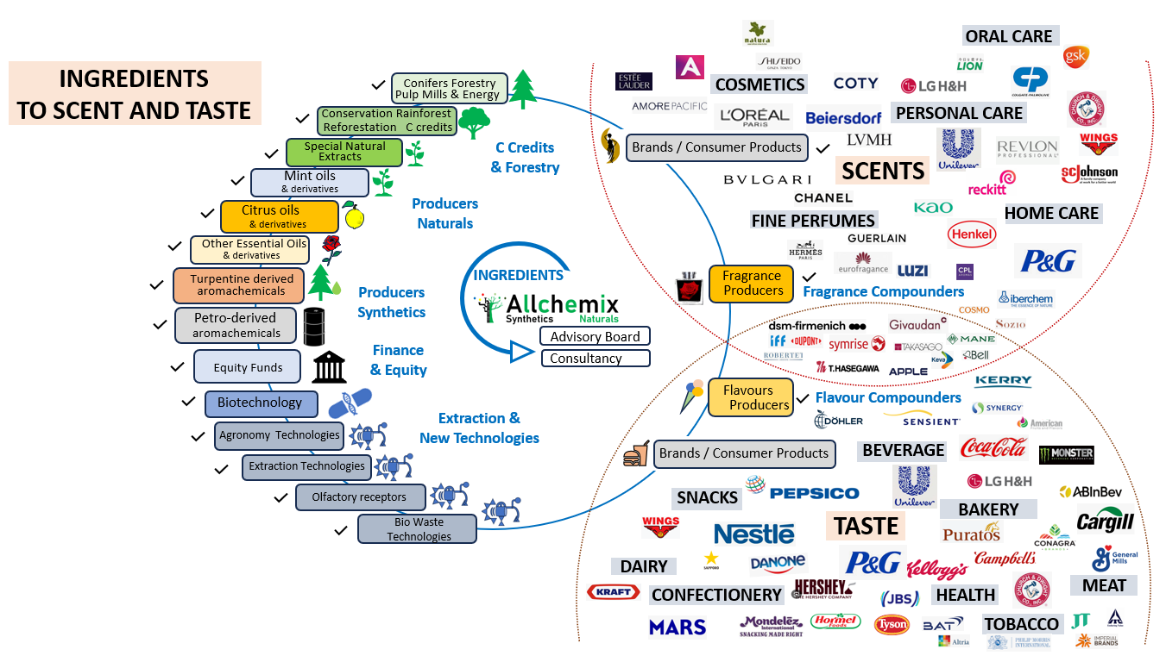






Allchemix Consultancy in the Value Chain…
Allchemix provides genuine Consultancy and Advisory Board services along the F&F value chain, from Raw Materials to Consumer Brands.
Alain Frix provides 34 years of experience in F&F ingredients, supply chain and markets
Master’s degree in Molecular Biology (University of Brussels) and MBA at Solvay Business school
Expertise in most F&F industry segments and at various layers
Strong, long-term relationships throughout the supply chain
Access to vast network of companies and other experts within the F&F value chain
Alain has developed unique excel datasets covering over 500 ingredients and their dynamics
Access to novel technologies in agronomy, extraction, conversion, olfactory receptors
An exceptional diversity of products, vast network of talented people, and fun at work
Allchemix has a global visibility on most of the F&F industry’s feedstocks
Advisory Board
Consultancy
Two main services from Allchemix : Advisory Board and Consultancy
Advisory Board
Strategic guidance
Alliances
M&A
Reality check assessment
Thinking out of the traditional F&F box
Finding the right people for growth
Commercial guidance
Allchemix sits on several advisory boards, often with multi-year assignments
Consultancy
Market mapping and analysis
Costs and Supply chain dynamics
Commercial support
Development Opportunities
Strategic support
Sustainability assessment
Network
Industry Support
7 Memberships
F&F + Cosmetics
>1500 industry contacts in Synthetics and in Naturals
spread over >350 F&F companies
IFEAT Executive
Committee and
Scientific
Educational work
Presentations at many
Conferences and Industry
Associations
Various publications in P&F
magazine, IFEAT World,
Expression Cosmétique,
and other magazines
Several articles are also
available on the website
www.allchemix.com
Allchemix works with a list of outstanding clients, carefully chosen based on
their ethics, their role in the F&F industry, and the absence of conflicting businesses
with other clients
Most clients are involved in multi-year assignments
Allchemix’s global Membership:
Alain is member of IFEAT’s
Scientific Committee, and
has been an active IFEAT
Executive Committee Board
member for 17 years, on
a voluntary basis. He is also
member of IFEAT Panel
of Experts
SFP (Société Française des Parfumeurs)
PCA (USA : Forestry derivatives from conifer biomass)
SEPAWA (Soap, Detergent and Cleaners)
DGP (German Society of Perfumers)
IFEAT (International Federation of Essential Oils and Aroma Trades)
BSP (British Society of Perfumers)
confidential

Slide 2
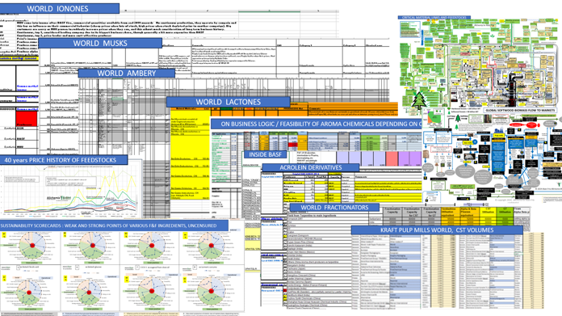
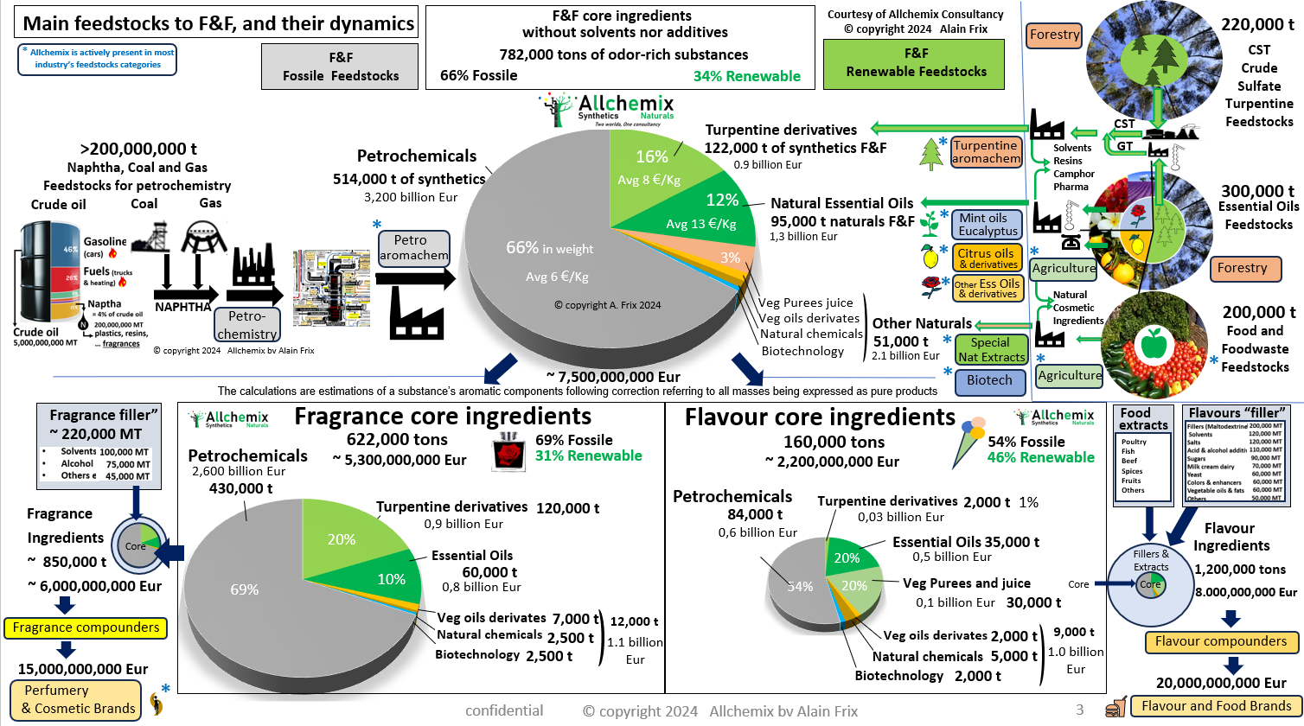
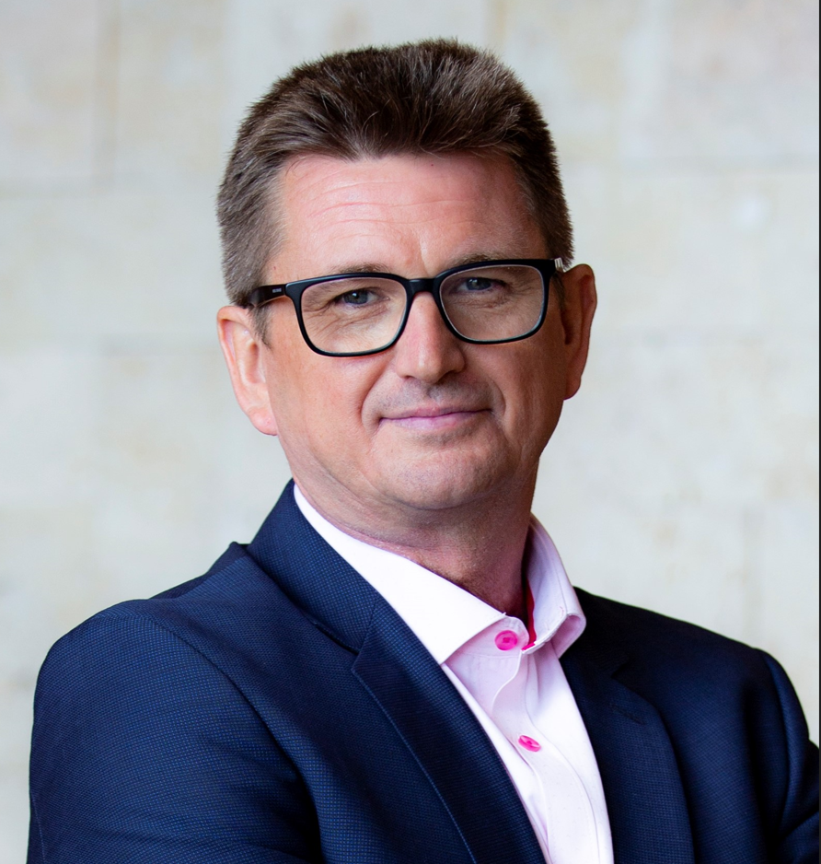
From Data to Knowledge, from Knoweldge to Analysis, from Analysis to Understanding, from Understanding to Decisions
Example of Allchemix Consultancy report formats: detailed reports with figures, without excessive text, and overview diagrams.
Code of Ethics and Operational Conduct : Commitment to support 10 key Principles
Allchemix BV is a one-man business, has no employees other than the owner himself, and does not use third parties to prepare its services.
This reinforces the safeguarding of confidential information provided by (and to) the clients.
Allchemix BV supports :
Transparency: Allchemix BV is committed to ensuring transparency in all decision-making that has an impact on customers, society and the environment.
Compliance with laws and regulations: Allchemix BV undertakes to comply with the laws, regulations and other legal obligations in force in all countries in which it operates, particularly with regard to human rights and environmental and labour laws.
Respect human rights: Allchemix BV undertakes to use its sphere of influence to promote the rights set out in the Universal Declaration of Human Rights.
Working together with mutual respect : Allchemix BV is committed to behaving in a professional manner with its customers, and to establishing professional relationships based on mutual trust, respect and human dignity.
Respect for the environment: Although Allchemix BV is limited to Services and does not produce any materials, it is committed to protecting the environment.
Respect property rights : Allchemix BV is committed to respecting the property rights of others.
Confidentiality: Allchemix BV undertakes to protect the confidentiality of information within the scope of its duties.
Anti-corruption: Allchemix BV condemns corruption in all its forms and complies with anti-corruption regulations & policies in force in the country of application.
Conflict of interest : Allchemix BV endeavours to avoid any activity that could lead to potential conflicts of interest. This is the reason why Allchemix BV is committed to support only one F&F house from the top league (DSM-Firmenich, Givaudan, IFF, Symrise, Mane, Takasago)
Compliance with competition law : Allchemix BV undertakes to comply with local laws and regulations designed to prohibit anti-competitive practices, including price fixing and bid rigging, and to promote open and fair competition.
Bio Alain Frix :
Alain Frix is based in Brussels, Belgium, and runs his own consulting firm, Allchemix BV, founded in 2020. He holds a master's degree in biology from the University of Brussels and a postgraduate degree in management from Solvay Business School.
With 34 years of experience in the perfumery and aromatic ingredients sector, Alain has worked with a diverse range of products, including forestry materials like turpentine, aromatic plants, essential oils, and petrochemicals. His broad commercial experience with multinational companies has enabled him to develop a vast global network within the fragrance, flavour, and cosmetics sectors. His expertise in both natural and synthetic ingredients makes him a trusted figure among manufacturers, producers, processors, formulators, and regulatory experts.
Through Allchemix BV, Alain continues to pursue his passion by advising carefully selected companies across the value chain—from forestry and ingredient producers to compounders, consumer goods companies, and brands. Allchemix BV is an active member of seven industry associations, including IFEAT, where Alain has volunteered on the Executive Committee for over 17 years. He has held several key positions, including Chair of the IFEAT Marrakech 2010 Conference Committee, Chair of the Executive Committee (2013–2016), Chair of the Scientific Committee (twice), and currently serves on IFEAT’s Panel of Experts.
Alain has participated in nine IFEAT study tours, visiting remote areas to meet with farmers and distillers of aromatic crops. He also writes for various magazines, sharing his candid views on the dynamics and challenges facing the industry.
www.allchemix.com alain.frix@allchemix.com

